Slide 1
TRANSACTIONAL
ANALYSIS
Prof. Parul Rishi
Faculty of Human Resource Management,
IIFM, Bhopal
parul@iifm.ac.in
Cell: 9009992144

Slide 2
TRANSACTIONAL ANALYSIS by Eric Berne :
Games People Play
SELF AWARENESS - A JOURNEY
disha

Slide 3
TRANSACTIONAL ANALYSIS definition
TRANSACTIONAL ANALYSIS (TA)
is a method of understanding communication between people;
T.A. is a system of analysing and understanding human relationships;
Transactional analysis was first developed by an American psychiatrist, Eric Berne, drawing on the theories of psychoanalyst Sigmund Freud.

Slide 4
Transactional Basis
Id – Pleasure Principle
Ego- Realistic Principle
Super-Ego- Ethical Principle

Slide 5
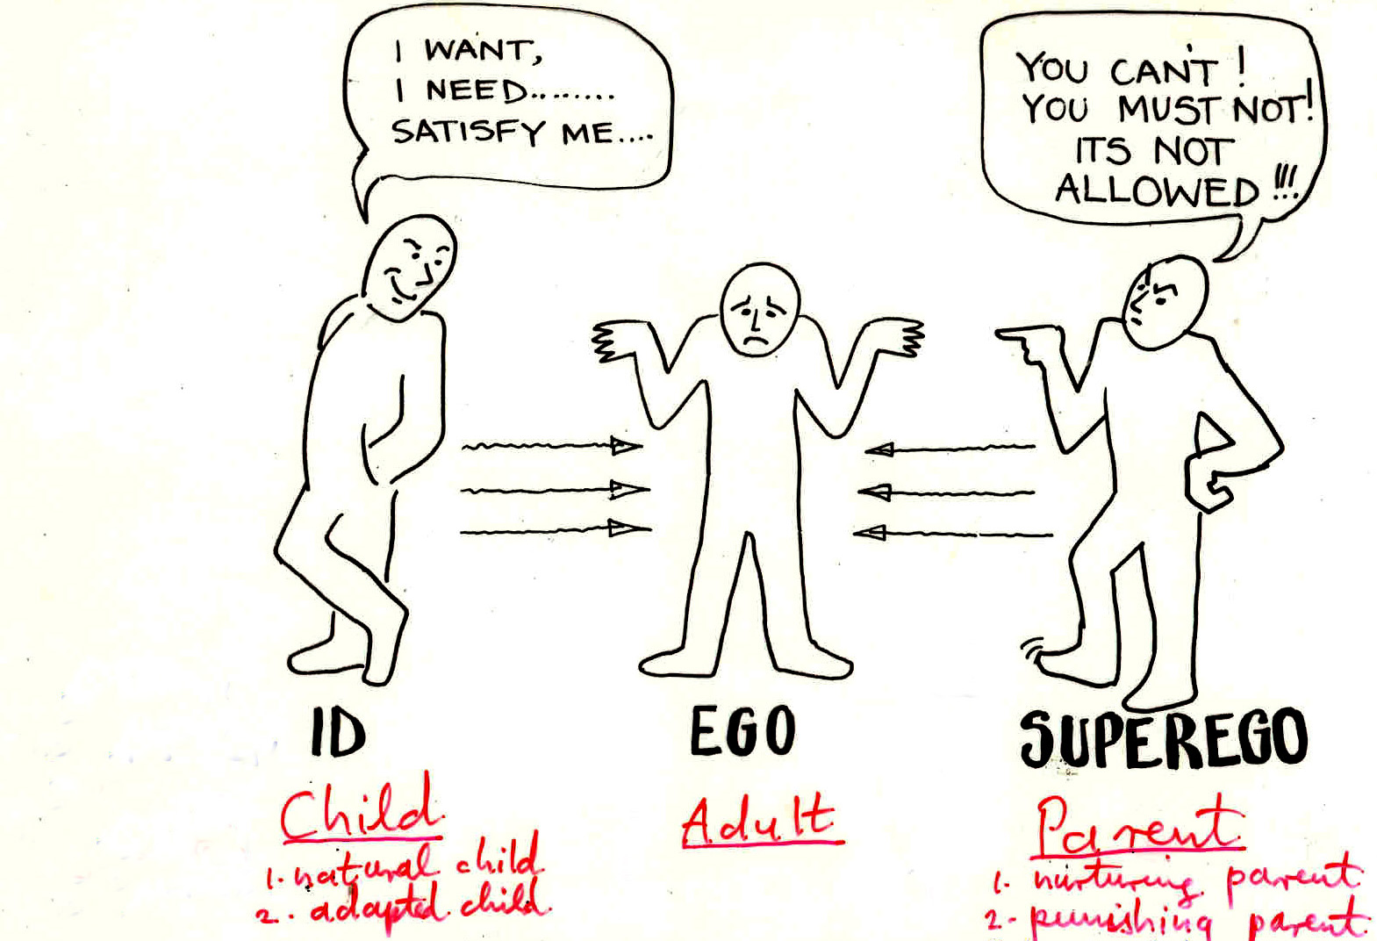

Slide 6
FREUD and BERNE
Freud’s mental states: ID, EGO, SUPEREGO
Berne’s ego states: CHILD, ADULT, PARENT
natural child nurturing p.
adapted child punishing p.
We can tell which ego state a person is in because
of the verbal and non-verbal behaviour
appropriate to each state.

Slide 7
TRANSACTIONAL ANALYSIS IS PRACTICAL AND USEFUL
IT GIVES A POSITIVE COMMUNICATION TOOL
PROVIDES BETTER INSIGHT INTO PERSONALITIES & TRANSACTIONS
HELPS SOLVE PERSONAL & FAMILY PROBLEMS
NON-THREATENING APPROACH OF SELF EVALUATION
IT IS EASY TO LEARN

Slide 8
STRUCTURAL ANALYSIS
TRANSACTIONAL ANALYSIS-
STROKE ANALYSIS
GAME ANALYSIS
SCRIPT ANALYSIS

Slide 9
TRANSACTIONAL ANALYSIS
Structural Analysis - How to analyse personalities
TRANSACTIONAL ANALYSIS- How people communicate
Stroke Analysis - How people recognise each other
Game Analysis - Ulterior Transactions
SCRIPT ANALYSIS - Life Positions

Slide 10

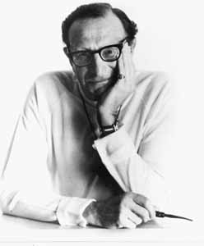
Ego States
Berne believed that when we interact with other people, our state of mind affects what happens
He believed that there were three states of mind in all humans, no matter how old they were, called ego states.
ADULT
PARENT
CHILD

Slide 11
The basic Structure of Human Personality
Parent
Taught Concept of Life
Adult
Thought Concept of Life
Child
Felt Concept of life

Slide 12
Eric Berne and Transactional Analysis
People have three ego states: parent, adult, child
    Parent: when a person thinks, feels & behaves in ways copied from his/her parents
    Child: thinking, feeling, behaving as one did as a child
    Adult: thoughts, feelings, or behaviors that are a direct result of current happenings
  Key point: people shift in & out of these states

Slide 13
The Three Ego States
Parent- “Do as I do”
Child- “What shall I do?”
Adult- “I will be frank with you”

Slide 14
The two levels of the Parent ego state
Nurturing Parent
Controlling Parent

Slide 15
The Three levels of the Child ego state
A
D
A
P
T
I
V
E
Natural Child
Rebellious Child

Slide 16
STROKES
We communicate with other people by giving
strokes.
A stroke is the basic unit of communication.
A stroke can be: a.) positive
b.) negative
c.) conditional
d.)unconditional
Strokes are fundamental units of social action.

Slide 17
TRANSACTIONS
An exchange of strokes between two people is the
basic transaction of human communication.
Transaction is the fundamental unit of social
intercourse.
Transactions can be:
a./ complementary
b./ crossed
c./ ulterior - games

Slide 18
Characteristics of Ego States
Each ego state has particular verbal and non-verbal characteristics, which can be observed, if you are watching people.
Each ego state has a positive and negative aspect

Slide 19


Look at the sentences below and match the ego state to the sentence.
It’s not my fault my drink got spilt on your new carpet
I wonder what might have caused that accident
For goodness sake, clean up that mess.
Shall we clean up the mess together with a wet cloth?
I refuse to get involved in this incident.
CHILD
ADULT
PARENT

Slide 20
Ego states
While the above ego states are present in all of us simultaneously, only one of these will be in command at any given moment in time. Furthermore, the states do not depend on the individual's age and each presents positive and negative aspects.

Slide 21
Shift in Ego States
Parent- “Why don’t you prepare a time-plan to handle your things properly?”
Child- “What is the point when one cannot follow it?” – Becomes an Adult.

Slide 22
Transactional Analysis
Three Basic Concepts: Parent, Adult and Child
Transactions: Among P, A and C
P < -- > P
A < -- > A
C < -- > C
There are 9 possible transactions
Notes:
Eric Berne M.D. Games People Play, Penguin Books, 1964

Slide 23
Transactional Analysis
Structural analysis –
Natural child – spontaneous, impulsive, feeling oriented, self-centered & pleasure loving
Adaptive child – compliant, conforms to the wishes & demands of parental figures

Slide 24
The Natural Child behaves as a child would do naturally, bringing together creativity, intuition and curiosity. The Natural Child enjoys life, expressed itself freely its feelings of happiness, sadness, anger and fear depending on the situation, and is spontaneous. The Natural Child is the state which loves.
The Adapted Child adapts its behaviour under the influence of its parents, behaving in the way that its parents would like it to, for example, with obedience or precociousness or perhaps also by showing reserve, by being vindictive or rebellious.
Rebellious Child

Slide 25
NC
People find me to be warm hearted and exuberant.
Sometimes people find that I am inconsiderate.
I enjoy speed, and whenever I get the chance I drive rather quickly.
I have a tendency of getting angry and of becoming impatient more often than I like.
I enjoy eating and drinking and all too often I indulge beyond a reasonable limit.
I am impatient with people who do not understand right away.
I've got lots of friends and we regularly get together to have a good laugh.
I know the right thing to say to make people feel at ease and to create an atmosphere of good humour.

Slide 26
Adult ego state
I have a habit of planning my work and my private life. This enables me to be relaxed and calm.
When my ideas are challenged during discussions, I readily question some of my points of view.
When I reflect on my life, I see that I have frequently changed my ideas and my points of view on fundamental issues.
Although I do not always agree with my boss on quite a number of issues, I nonetheless get on very well with him.
At work, moral values and feelings are more important than many people believe.
I take part in a number of activities outside of work and have the feeling that I am not as bored as most people.
I enjoy a happy life. I have built up and continue to build up a positive relationship with my spouse and my children.

Slide 27
Transactional Analysis
Nurturing parent - comforts, praises and helps others
http://www.okcupid.com/quizzy/take
Critical parent – finds faults, displays prejudices, disapproves and prevents others from feeling good about themselves
A major goal is to figure out which ego state a person is using
http://www.okcupid.com/quizzy/take

Slide 28
NP
My children mostly call me by my first name. Or other young children if you don't have any yourself.
Mostly true Mostly false
I readily lend my belongings to others without worrying about whether or not they will be returned to me.
Mostly true Mostly false
Family life is important to me and I like my spouse and my children.
Mostly true Mostly false
I chose to do difficult and non-gratifying work myself.
Mostly true Mostly false
When bringing up children, it is vital to base one's relationship with them on trust.
Mostly true Mostly false
The real battle of today is the fight against poverty.
Mostly true Mostly false
Whatever people say, children need us for a far longer period of time than we believe and one must be ready for this.
Mostly true Mostly false
It is the done thing to sacrifice oneself for the happiness of one's children.
Mostly true Mostly false
Things have to be changed and a more just and egalitarian society must be fought for.
Mostly true Mostly false
I am more of the generous type. I like giving presents but I often spend too much.
Mostly true Mostly false

Slide 29
CP
I like work that is done well, that is precise and is finished within the allocated time limit.
Sincerity is fundamental to human relations. I am not afraid of telling others what I think.
When faced with difficulties I do my duty.
It is sad that certain forms of politeness and propriety are dying out.
Before making a decision, every possible choice should be looked into.
The greatest joys in life are to be had through self effort and by going beyond one's limits.
Life takes on meaning when one fights for a righteous cause.

Slide 30
Transactional Analysis
Transactional analysis - Transactions between people are seen as having 3 levels:
Complementary – both people are operating from the same ego state
Crossed – the other person reacts from an unexpected ego state
Ulterior – two ego states within the same person but one disguises the other

Slide 31
Types of Transaction
Complementary Transactions
This is a complementary transaction because the employee accepts the child ego state assigned to him by the director and responds in child ego state.
P
P
A
A
C
C
DIRECTOR
EMPLOYEE
“You’re three hours late, I want an explanation.”
“I’m really sorry, I slept through the alarm, it won’t happen again, I promise.”

Slide 32
Crossed Transaction
This is a crossed transaction because although the manager, parent ego state, attempted to address the employee as a child, the employee refuses this ego state and responds in adult ego state to the manager’s ego state.
A crossed transaction is any transaction where the person being spoken to refuses the ego state they are assigned by the first speaker.
P
P
A
A
C
C
DIRECTOR
EMPLOYEE
“You’re three hours late, I want an explanation.”
“Oh, didn’t you get held up by that accident on the road as well?”

Slide 33
Types of Transactions (Con..)
Crossed Transaction: This causes most difficulties in social situations.
“May be, you should improve your way of delivering lecture”.
“You always find fault with me whatever I do” Parent-Child interaction.

Slide 34
Transactional Analysis
Game analysis - ulteriorly motivated transactions that appear complimentary on the surface but end in bad feelings:
1st Degree games – minor upset, played socially end up with minor discomfort
2nd Degree games – more intimate end up with bad feelings
3rd Degree games - usually involve physical injury

Slide 35
Transactional Analysis
Very few games have a positive or neutral outcome
In these games, people play one of three positions:
Victim
Persecutor
Rescuer

Slide 36
Transactional Analysis
Script analysis – everyone develops a life script by age 5 & these scripts determine how one interacts with others based upon the interpretation of external events
A negative life script occurs when the person receives lots of injunctions by the parents that used the word DON’T

Slide 37
Transactional Analysis
Common negative life scripts:
Never – one never gets to do what one wants
Until – one must wait until a certain time or until something is done to be able to do something they want to do
Always – one must continue to do what one has always done

Slide 38
Transactional Analysis
After – a difficulty is expected after a certain event
Open-ended – one does not know what to do after a given time
Mini-scripts: Hurry up! Try harder! Be perfect! Be strong! Please someone! These drivers allow for temporary escape from life scripts

Slide 39
Know your TA style???

Slide 40
A HURRY UP Style !
Type A Personality
People with hurry up styles like to do everything as quickly as they can.
They are energized by having deadlines to meet, and they always seem able to fit in extra tasks.
They tend to be quick to come up with solutions to problems.
In a mentoring relationship…
They want an instant relationship, without taking time to get to know their mentoring partner.
They can’t see why there is a need to have so many stages in the mentoring process – why can’t they go straight to the action stage?
A HURRY UP personality will work well under time pressure because their energy will be high
For improvement a ‘Hurry Up’ needs to:
- think and plan ahead with regard to the REALITY of available time
- have short term goals with defined standards

Slide 41
BE PERFECT
Type A Personality
Be Perfect people are energised by doing things right.
They aim for perfection in everything, check carefully, produce accurate work and set high standards.
Sometimes they will miss deadlines because they may have a weak sense of priorities and insist everything is done perfectly, so they can come across as overly critical.
In a mentoring relationship…
They make little allowance for human failings. They may get discouraged if they fail to live up to their own high expectations and lose faith in a mentoring partner who makes a mistake.
A BE PERFECT personality works well in jobs where detail is important and the set standards are important.
For improvement needs to:
- realise that less than their best may be what is needed at the early stages
- realise that their qualities of accuracy and organisation may have a poor impact on those with different mindset.

Slide 42
PLEASE PEOPLE-A Non Assertive Class
Like to get on with everyone and energised by approval and harmony.
They make good team members because they involve others as a way of making sure they are happy.
Use their intuition to pick up when someone has doubts; they notice the little signs and the body language that others may ignore. On the other hand, they may be reluctant to challenge anyone in case they lose that person’s approval.
In a mentoring relationship…
They may worry too much about gaining the approval of their mentoring partner.
They may attempt to read their partner’s mind, and then say what they think the partner wants to hear.
When they talk, they may make everything sound like a question, so they can quickly back down if their suggestions don’t meet with instant agreement.
Can hold a team together and perform the 'maintenance' functions of involving people, checking and summarising, and will be sympathetic, empathetic, tolerant and flexible.

Slide 43
TRY HARD
Try Hard people are enthusiastic, get involved in lots of different activities, and tend to volunteer for things.
They are energised by having something new to try.
Sometimes they turn small jobs into major projects because they are so enthusiastic at following up every angle.
They may then become bored with the detailed work that follows, even to the point of leaving work undone so they can move on to a new, exciting activity.
In a mentoring relationship…
Try Hards are likely to be very enthusiastic mentoring partners to begin with.
They will be keen to try out the various aspects of the mentoring process.
They may even introduce ideas and activities to the mentoring. However, their enthusiasm may not translate into action.
A TRY HARD personality is very good in start up situations, and where effort and energy to complete are needed.
For improvement needs to:
- finish some things and put some full stops into their sentences
- follow through when necessary

Slide 44
BE STRONG
People with Be Strong working styles pride themselves on their ability to stay calm in any circumstances.
They are energised by the need to cope. They are good at dealing with crises, can handle difficult people, and will work steadily through any workload.
However, their desire to have everything under control means they can come across as aloof.
They are also reluctant to ask for help, even when they should, and their lack of awareness of emotions may make them insensitive to the feelings of others.
In a mentoring relationship…
May find it hard to accept any help from others. Even talking about problems may be difficult, as Be Strongs are reluctant to admit to weakness, even to themselves.
They are good in accommodating poor conditions or putting up with things that many would find unreasonable
For improvement needs to:- learn to relax- admit to being weak in some situations

Slide 45
Typical Games
Between director and faculty:
“This training is challenging, you cannot take it , I believe”
Between A Teacher and a Student:
“This is a good topic, but you cannot handle it.”

Slide 46
Transactional Analysis
Four basic life scripts:
I’m OK, you’re OK – ideal
I’m OK, you’re not OK – get away from me
I’m not OK, you’re OK – I’ll never get anywhere
I’m not OK, you’re not OK – get rid of each other

Slide 47
Life Positions
I’m OK — I’m OK —
You’re not OK You’re OK
I’m not OK — I’m not OK —
You’re not OK You’re OK
Positive
Negative
Attitude toward Oneself
Negative Positive
Attitude toward Others

Slide 48

Management Conflict Styles
I’m
not OK —
You’re OK
I’m OK —
You’re OK
Passive
behavior
Assertive
behavior
High concern
for others’
needs
Accommodating
style
Collaborating
style
Compromising
style
Aggressive
behavior
Avoiding
style
Forcing
style
I’m
not OK —
You’re not OK
I’m OK —
You’re not OK
Low concern
for others’
needs
High concern
for own
needs

Slide 49
UTILITY
Communication
Motivation
Leadership

Slide 50
DEVELOPING IP Skills
Developing Assertiveness
Accepting Responsibility
Managing Conflicts
      Avoiding
      Accommodating
      Competing/Forcing
      Collaborating
      Compromising

Slide 51
Factors Hampering Interpersonal Interactions
Poor Listening
Emotional Arousal
Lack of Time
Differences in objective

Slide 52
Building Positive Relationship
Use of ‘I’
Focus on problem solving
Don’t Deceive
Empathy
Listen
Use of Praise
  Be specific
  Praise progress
  Sincere
  Don’t overdo
  Timing

Slide 53
Dealing with Criticism
Understand the Reason behind
Empathy
Don’t personalize criticism
Do not be Judgmental
Do not overload

Slide 54
THANK YOU FOR YOUR KIND ATTENTION
drparulrishi@gmail.com

